Slide 1
Our Egg Experiment
Ms. Evans’ Class

Slide 2
What would happen if we dropped this egg into this liquid?

Slide 3
 | Observations | Predictions
Egg | Hard Cold No smell Oval shaped White Fragile | Not edible Softer Cracked Shrivel Shrink Rotten Smelly Yellow Brown Disappear
Liquid | Clear/white Smells like vinegar Room temperature Wet Loose/fluid ***BUBBLES after egg*** | Filled with shells Filled with yolk White Pinkish Amount of liquid would decrease

Slide 4
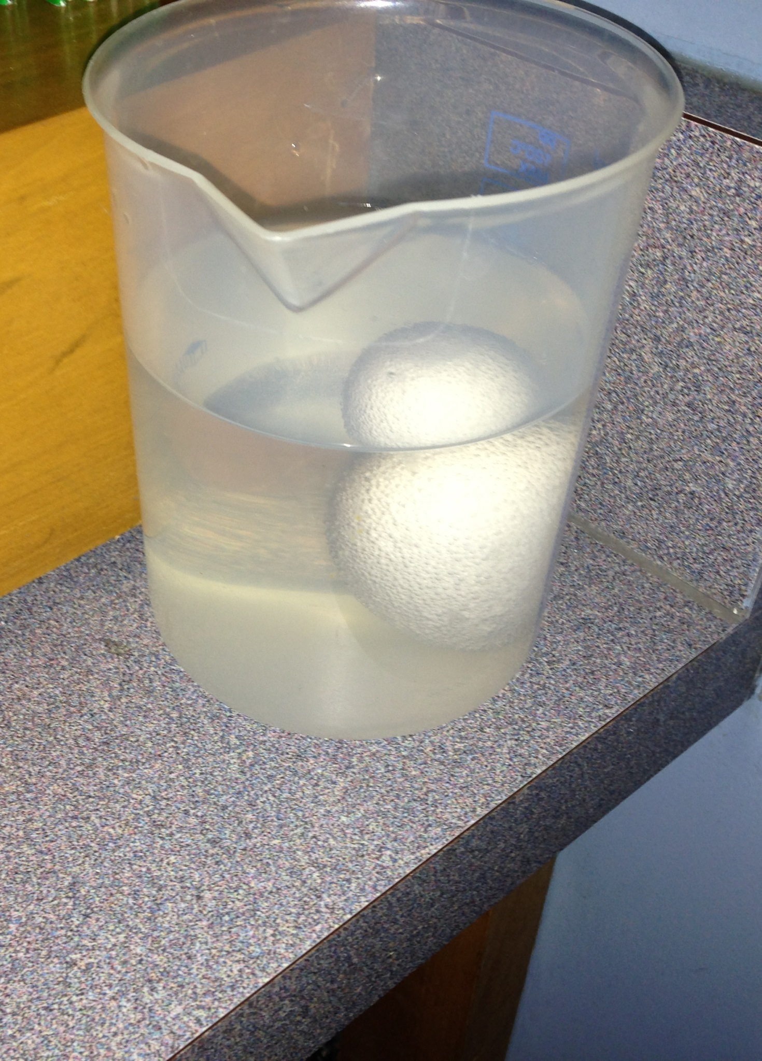
DAY 1

Slide 5
NE W OBSERVATIONS
Egg looks larger
Bubbles on it
Looks brown/ yellow/ clear
Egg floating and looks cracked and softer
Liquid decreased
Shell looks thinner
Looks like salt on top
Still smells like vinegar

Slide 6
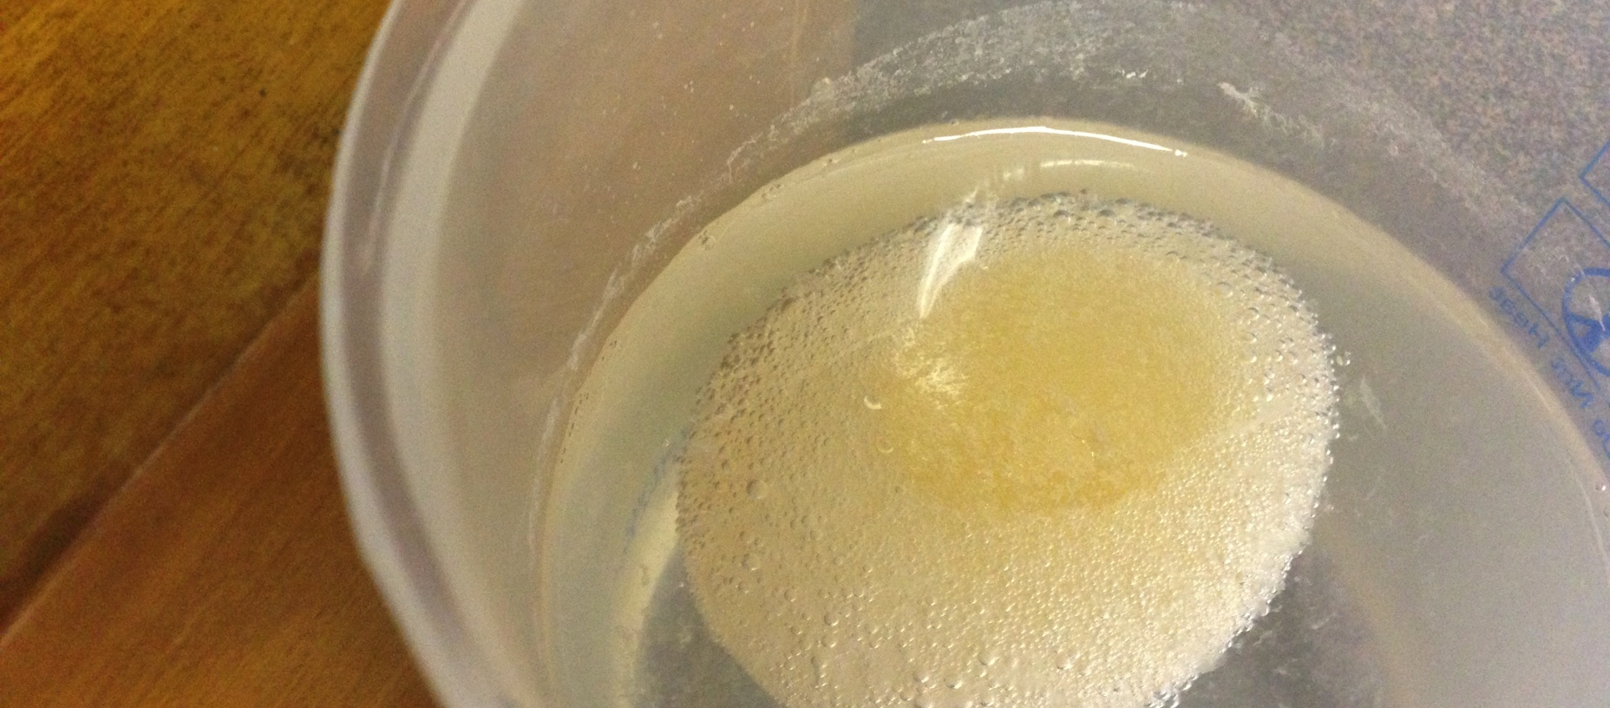
Day 2

Slide 7
Conclusion
The “mystery liquid” dissolved the egg’s shell. The remaining part of the egg was rubbery and soft.
The mystery liquid was vinegar which contains acid. The acid in the vinegar began to corrode the egg’s calcium carbonate shell as soon as it was dropped in the jar thus we saw bubbles (the release of the carbon dioxide).

Slide 8
What if’s……
What if we soaked the egg in milk?
What if we soaked the egg in soda?
What if we soaked the egg in orange juice?
What if we soaked the egg in water?

